Slide 1
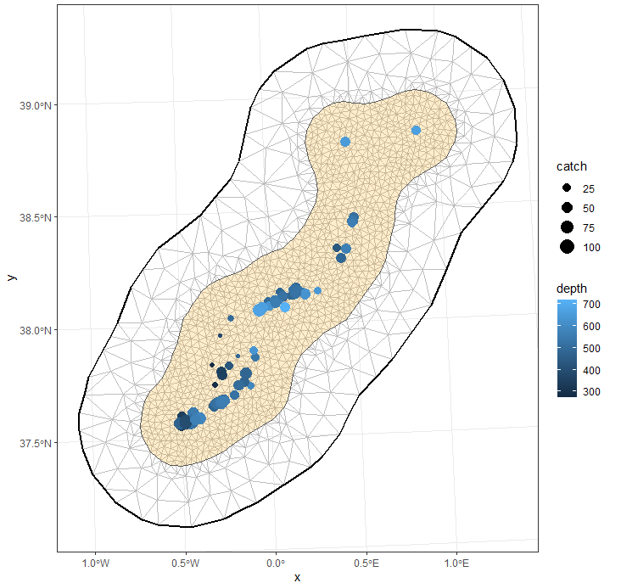
Hands on!
A gentle introduction to inlabru

Slide 2
Preferential sampling
Counts
Poisson
Points
Log-Gaussian Cox Process

Slide 3
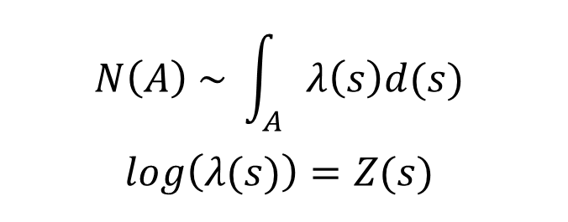

Points: Log-gaussian Cox Process
$$N\left(A\right) \sim \int_{A}{λ\left(s\right)d(s)}$$
$$log\left(λ(s)\right)=Z(s)$$
$$Z\left(s\right)= β_{0}+β_{1}x_{1}+β_{2}x_{2}+β_{3}x_{3}+ W\left(s\right)$$

Slide 4
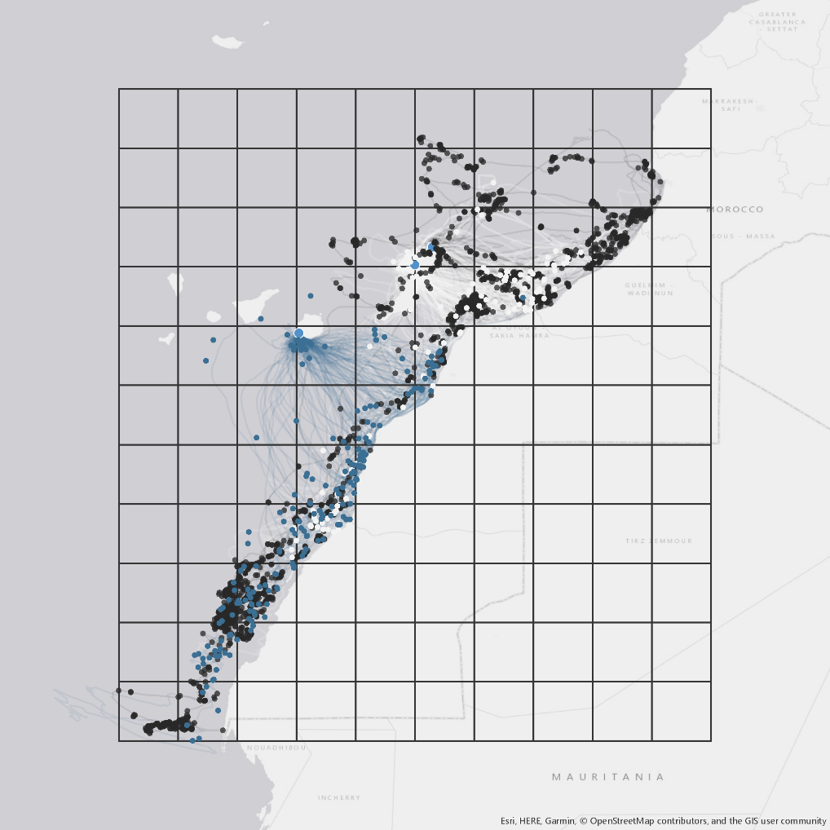
Points: Log-gaussian Cox Process
Traditional SDM approach: grid
- Loss of information
- Scale dependent
- Spatial autocorrelation ignored

Slide 5
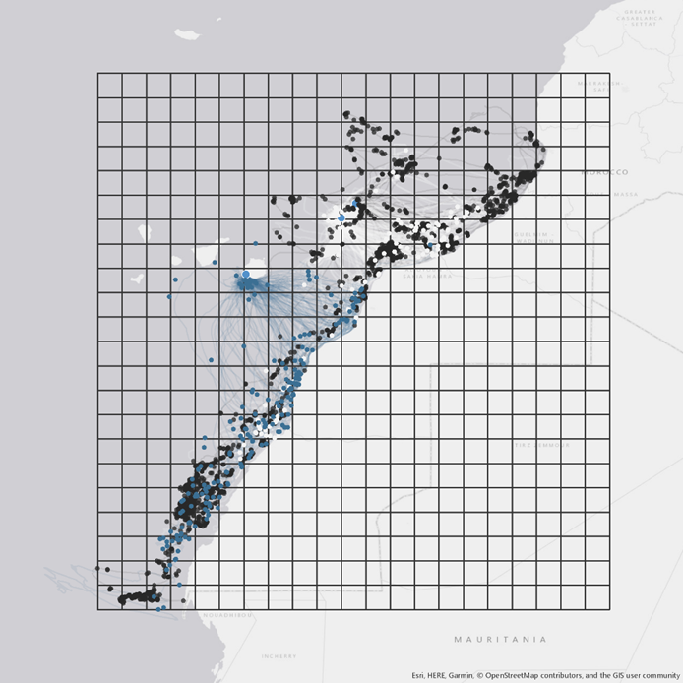
Points: Log-gaussian Cox Process
Traditional SDM approach: grid
- Loss of information
- Scale dependent
- Spatial autocorrelation ignored

Slide 6
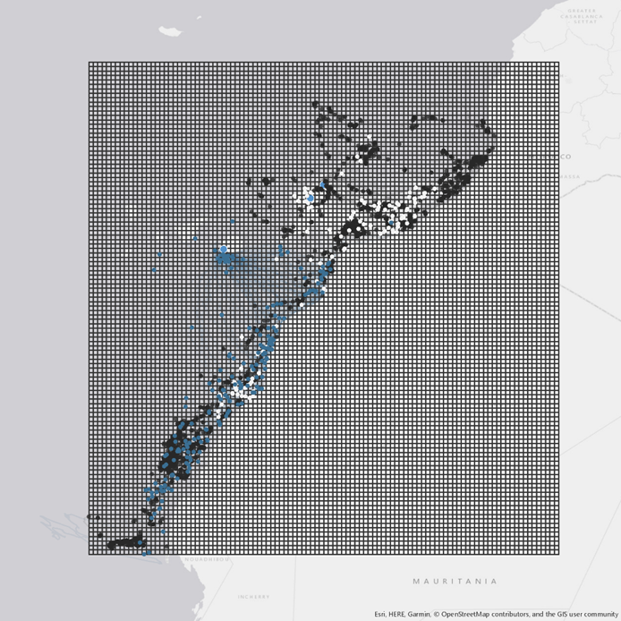
Points: Log-gaussian Cox Process
Traditional SDM approach: grid
- Loss of information
- Scale dependent
- Spatial autocorrelation ignored

Slide 7
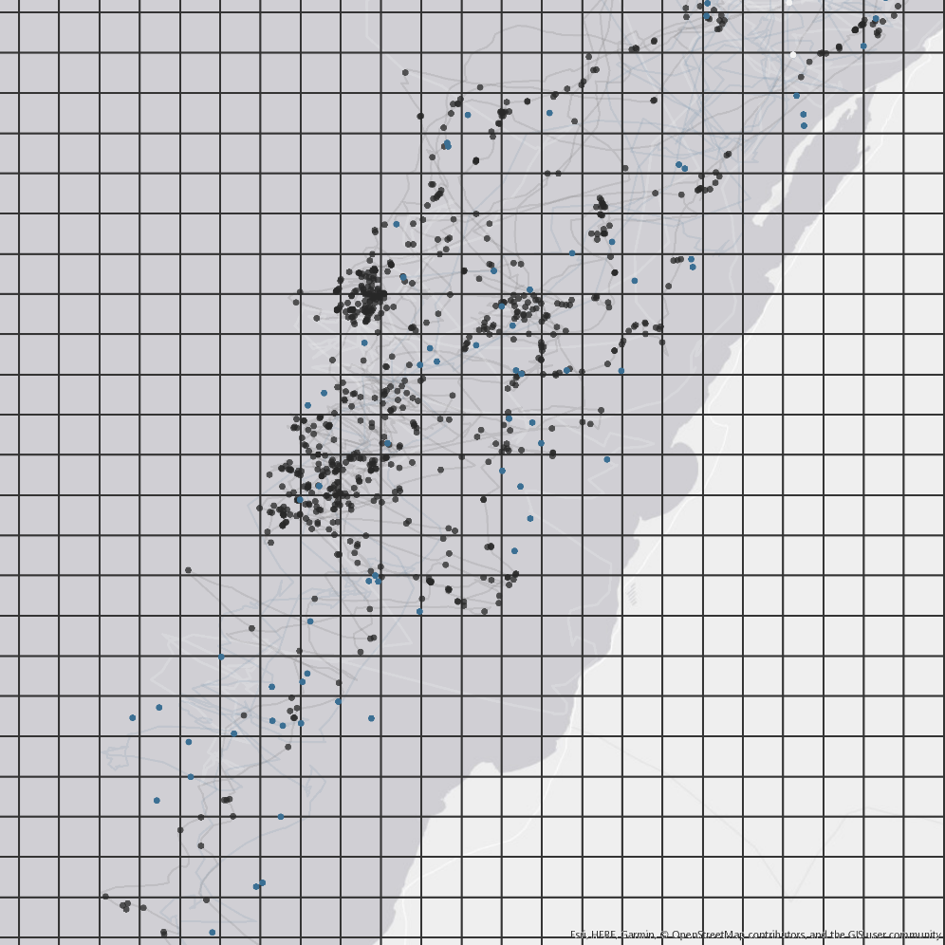
Points: Log-gaussian Cox Process
Traditional SDM approach: grid
- Loss of information
- Scale dependent
- Spatial autocorrelation ignored

Slide 8
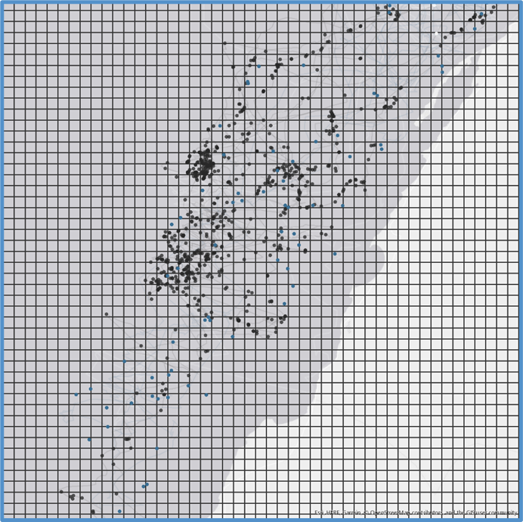
Points: Log-gaussian Cox Process
Traditional SDM approach: grid
- Loss of information
- Scale dependent
- Spatial autocorrelation ignored

Slide 9
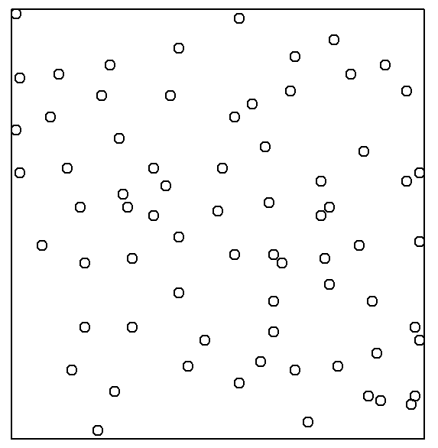
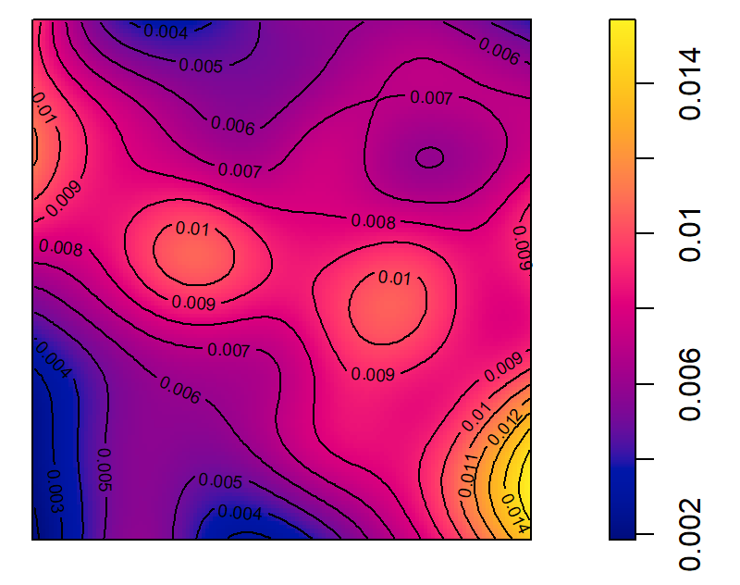
Points: Log-gaussian Cox Process

Slide 10
Points: Log-gaussian Cox Process
$$N\left(A\right) \sim \int_{A}{λ\left(s\right)d(s)}$$
$$log\left(λ(s)\right)=Z(s)$$
$$Z\left(s\right)= β_{0}+β_{1}x_{1}+β_{2}x_{2}+β_{3}x_{3}+ W\left(s\right)$$

Slide 11
Points: Log-gaussian Cox Process
Go to R script 1_lgcp.R…
… and don’t panic

